Slide 1
Blackjack - Design
Group 5

Slide 2
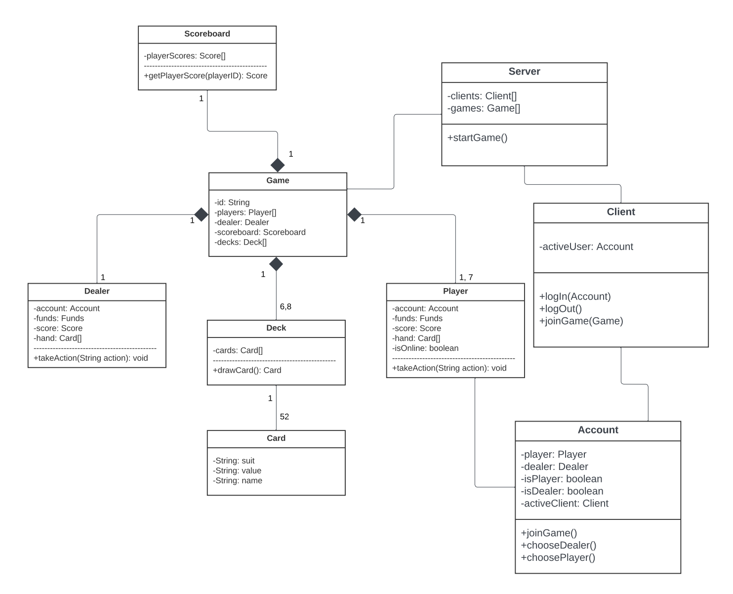
UML Diagram
Account, Player, Dealer, Client
An account is logged into on a client and is displayed a main menu.
On the main menu, the user is able to choose to be a player or a dealer for a game, and can then join a game with one of these roles.
Depending on their chosen role, they will have different options in the game according to the rules of blackjack.

Slide 3
UML Diagram
Game, Deck, Card, Scoreboard
Every game has one dealer and at least one player. All users are dealt cards and presented button actions according to Blackjack rules.
There can be 6 to 8 decks per match and each deck contains 52 cards.
During each game, a scoreboard is calculated showing the amount of wins, bets, and funds per player as well as a leaderboard.

Slide 4
UML Diagram
Server
A server can be connected to many clients as well as host many games.

Slide 5
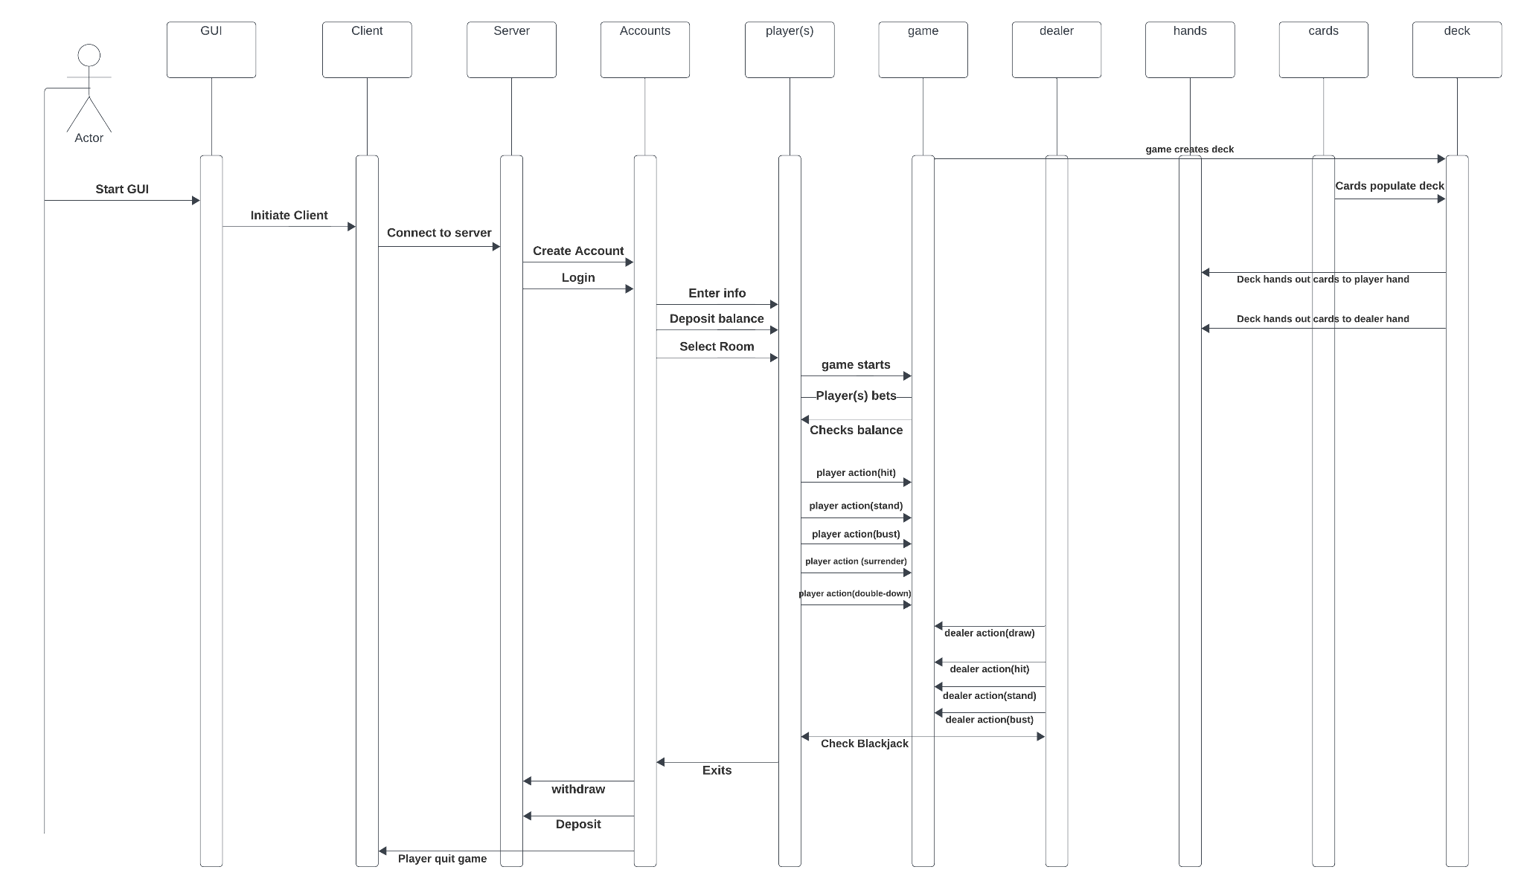
UML Sequence
Start GUI.
Initiate client.
Connect to server.
Create Account/Login.
Enter info/Deposit Balances/Selection room.
Game starts with players actions like bets, hit, stand or bust. Also dealer actions too.
Game creates decks while cards populate deck.
Game checks if player or dealer get Blackjack.

Slide 6
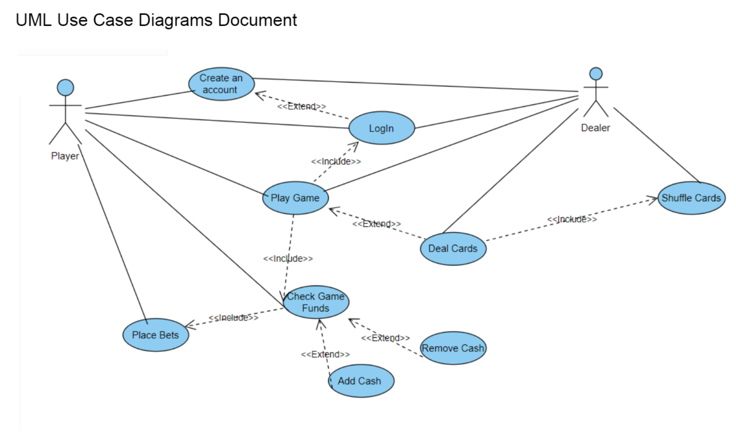
UML Use Case
Login
Can create account, if necessary
If login is successful, then user can choose player or dealer
Play game
Players can check game funds
Players can hit or stand
Players can place bets
Dealer can shuffle and deal cards
Dealers can also hit or stand
Players either win or lose, funds will adjust accordingly

Slide 7
GUI Flow
At program start, users are shown a window to log in with their username and password (or register). Once logged in they are in a main menu that allows them to choose between picking player and dealer.
After picking, they may join a game and will be included in the next round. In-game, they are allowed to place a bet for a round and after the round starts they are presented with their dealt cards and buttons to hit or stay.
In-between rounds, users are presented with a button to leave the game.
Users have an option to view the scoreboard, as well as being displayed their updated funds after every round.

Slide 8
A sneak peek..

Slide 9
Thank you!

